Slide 1
Naval Postgraduate School
Maritime Multimodal Information Sharing Team
Dr. Susan Hocevar
Anita Salem
Wendy Walsh
Lyla Englehorn
555 Dyer Road, IN-270
Monterey, CA 93950
(831) 277-6616
shocevar@nps.edu
Notes:
Challenge
Include the private sector in national MDA efforts
Gather local perspectives of practitioners
Provide value to the private sector
Purpose
Provide a process for two-way sharing of threat information
Provide a forum for mutual problem solving around MDA issues
Current sponsors and government stakeholders
Maritime Defense & Security Research Program (NPS)
Maritime Administration (US Department of Transportation)
USCG, GMSA & GMAII, CBP, ICE, JTTF, NCAGS and GMISS
Status
August 2008: Piloted at MIST Long Beach/Los Angeles
May 2009: Modified and expanded for MIST Puget Sound
FY2010: MIST Honolulu HI (November 2009),
MIST NY/NJ (May 2010-pending funding)

Slide 2
Who we are
shipping security and the private sector
an interagency process for information sharing & collaboration
with a focus on private sector shipping
through private & public sector partnerships
Notes:
Challenge
Include the private sector in national MDA efforts
Gather local perspectives of practitioners
Provide value to the private sector
Purpose
Provide a process for two-way sharing of threat information
Provide a forum for mutual problem solving around MDA issues
Current sponsors and government stakeholders
Maritime Defense & Security Research Program (NPS)
Maritime Administration (US Department of Transportation)
USCG, GMSA & GMAII, CBP, ICE, JTTF, NCAGS and GMISS
Status
August 2008: Piloted at MIST Long Beach/Los Angeles
May 2009: Modified and expanded for MIST Puget Sound
FY2010: MIST Honolulu HI (November 2009),
MIST NY/NJ (May 2010-pending funding)

Slide 3
Our history
2008 LA/LB
2009 Puget Sound
2010 Honolulu
2010 Delaware Bay
2011 Boston
Motivations
Cultural influences
Fusion center partnerships
Design of information
Train security personnel
Embedding employees
2012 Baltimore
Intermodal relationships
Interagency collaboration
AMSC FSO subcommittees
Face-to-face meetings
Collaborative capacity
Operational security
Notes:
To date, our team has been to six different locales in the United States, and we will be holding our next workshop in the San Francisco Bay area. With each of the sites that we've worked with, we developed a greater appreciation for the different issues that are facing the private sector regarding sharing of information. In our early days it was important that we gain an understanding of the private sector perspective – specifically their information needs and their motivations for sharing. As we moved forward, we started to focus much more on working with public and private sector stakeholders to understand and build what we call collaborative capacity—that is, the ability to actually work together to improve the information sharing systems.

Slide 4
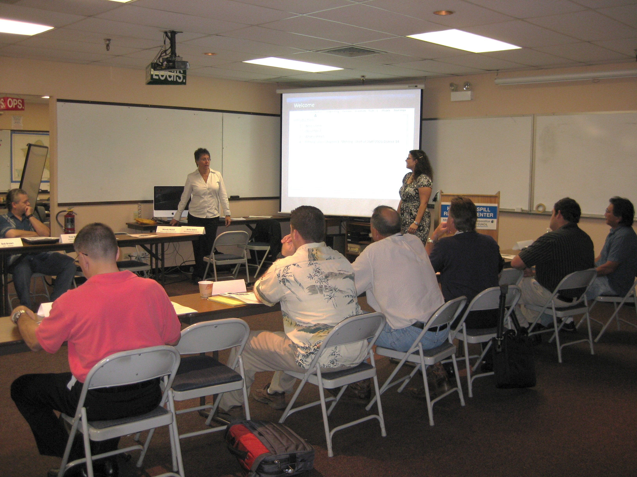
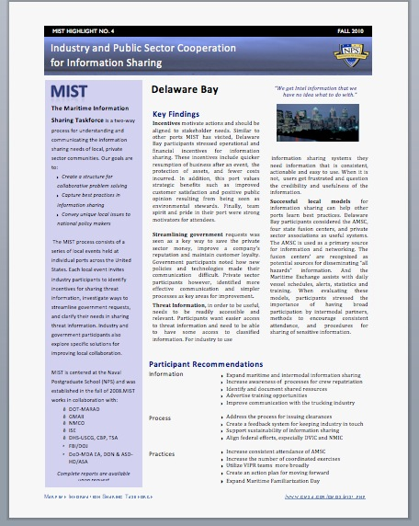
Our mission
To integrate local, private sector perspectives into the national picture for the sharing of threat information.
Capture
Facilitate
Local practices and challenges
Issues and solutions
Collaborative problem solving
Communicate

Slide 5
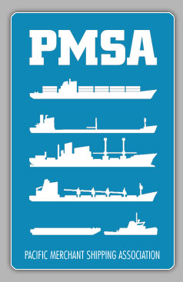
Workshop goals
Motivation
Information
Collaboration
Who is key to sharing?
Why share information?
Which threats matter most?
What information is needed?
How to improve collaboration?
What are local best practices?
What can be done to improve?

Slide 6
Findings across 6 ports…
Motivation
Information
Collaboration
People are more alike than not
Human motivations are similar
People have common information needs
Collaboration issues are shared
Notes:
How can the public sector better engage with the private sector?
How can we create complementary value?
How can government frame their needs to better align with industry?

Slide 7
Moving forward
Provide value to you…
Who should be included?
Remember…the focus is on the private sector
What are your areas of concern?
How can we help you get ahead of the game?
Questions?

Slide 8
Findings: stakeholder motivations
Show the cost/benefit
Recognize the need for business advantage
Address the impact on throughput
Aid in decision-making
Align with safety focus
Honor the drive for excellence
Support community needs
Build trusted relationships
Be aware of local practices and beliefs
Financial
Operational
Strategic
Social
Cultural

Slide 9
Findings: information quality
Easy to access
Two way communication
Standardized
Simple
Customizable
Commercial quality
Actionable
Targeted
Credible
Accessible
Easy to Use
Useful
Notes:
Easy to access
No clearance required
Anytime, anywhere, any device access
Easy reset of passwords
Information is pushed to users
Two-way communication
Alerts and trends
Feedback when reporting
Standardized
Centralized reporting and receiving
Standardized processes
Standardized data collection
Simple
Clear topic navigation
Plain language
Important information first
Customizable
User selectable alerts
Organized by industry, interest, and location
Commercial quality
Good customer service
Modern capabilities
Actionable
Impact on cargo flow and operations
Recommended actions
Trends for prediction
Targeted
To affected regions and work roles
Broken down by hazard type
Credible
Not tied to regulatory
Accurate, up-to-date information
Secure

Slide 10
Findings: collaborative capacity
Facilitate commerce
Provide adequate resources
Provide clear guidance
Build support structures
Coordinate communications
Extend exercises
Develop mutual respect
Understand the domain
Build organizational incentives
Strategic Purpose
Structure
Lateral Mechanisms
People
Incentives
Notes:
Quotes
“We’re already linked together now in a business sense…we’re all integrated.”
“The private sector may not have funds to invest in infrastructure and even though the public sector agrees it is important, they won’t fund it…
“Maybe I’d have done things differently had I known—I’d have been more alert”
“We’re in the business of making money”
“Shut down Sand Island and you shut down the State of Hawai’i.”
“When you share threat information, it allows the private sector to focus their efforts more effectively”
“Like any multicultural group, when you get any group of employers together, they are going to find a common goal and work hard toward it, but will (also) focus on ‘what serves my needs’.”
“We definitely don’t have adequate budget for collaboration.”
: “The bottom line is that we don’t necessarily have the resources to spend on sharing information in the first place, we only have the resources to respond to a threat and meet our mission.”
“Government doesn’t aid commerce—but it’s a fact of life” “Choose a system and improve it, rather than improving all ten.”

